Slide 1
INTERNSHIP (JUNE - 2026)
Department of Computer Science and Engineering
Chennai Institute of Technology
NAME: Vasanthavel K
REG NO: 24CS1021
SEMESTER: V
TITLE: Design and Optimization of an Agentic RAG Context Engine & Multi-Agent Orchestration Platform

Slide 2
INTRODUCTION
In autonomous software development, monolithic LLM developer prompts suffer from context window limits, high latency, and expensive API costs.
This internship focuses on designing a modular, supervisor-directed RAG framework that isolates agent concerns into a collaborative state graph using LangGraph.
We introduce surgical context reduction tools, dynamic hybrid retrieval, and semantic query caching to optimize token load and inference latency.

Slide 3
Goals of the Internship
• Implement a production-grade multi-agent coordination system using LangGraph and a Supervisor routing pattern.
• Configure a robust hybrid search index using Weaviate Cloud (BM25 + Semantic) with local fallback databases.
• Design surgical context compression, symbol-based signature fetchers, and diff-based code generators (apply_surgical_edit).
• Debug and resolve live API routing issues, caching crashes, and safety boundary constraints on a multi-repo codebase.

Slide 4
Why Modular RAG & Multi-Agents?
Feeding entire code files and log streams to LLMs results in 'lost in the middle' problems, poor code generation, and high costs.
Isolating complex tasks (retrieval, search, code writing, execution, criticism) into specialized worker agents improves system reliability.
By adopting a surgical diff-based editing tool (apply_surgical_edit), we target only the modified functions, bypassing the need to regenerate unaltered boilerplate code, which reduces latency from ~30s to <1s.

Slide 5
Methodology: Multi-Agent Architecture
• Supervisor Pattern: Coordinates routing using a central LangGraph state. Dispatches subtasks and resumes state upon worker outputs.
• RAG Worker: Queries indexed knowledge via Weaviate and returns grounded document matches.
• Coding & Critic Workers: The Coding Worker generates structural modifications; the Critic Worker verifies code safety and syntactical accuracy.
• Web & Scraper Workers: Fetch live web data (via Tavily API) and extract raw text from target links.
• Utility Worker: Computes statistics and manages session history.

Slide 6
Methodology: Core Retrieval Innovations
• Dynamic Hybrid Retrieval (Alpha Shifts): Automatically detects query type. For technical/code queries, shifts alpha to keyword-matching (0.25); for natural language, shifts to semantic (0.75).
• Semantic Cache Layer: An in-memory, query-hash keyed cache matching previous queries to bypass vector DB calls entirely, eliminating latency for repeated questions.
• Neural Reranking: Employs a local FlashRank Reranker (ms-marco-MiniLM-L-6-v2) to filter initial search outputs and surface high-relevance chunks.
• Hybrid Local Database Fallback: Uses a local JSON/SQLite vector store when cloud connectivity is degraded, ensuring zero uptime dependency.

Slide 7
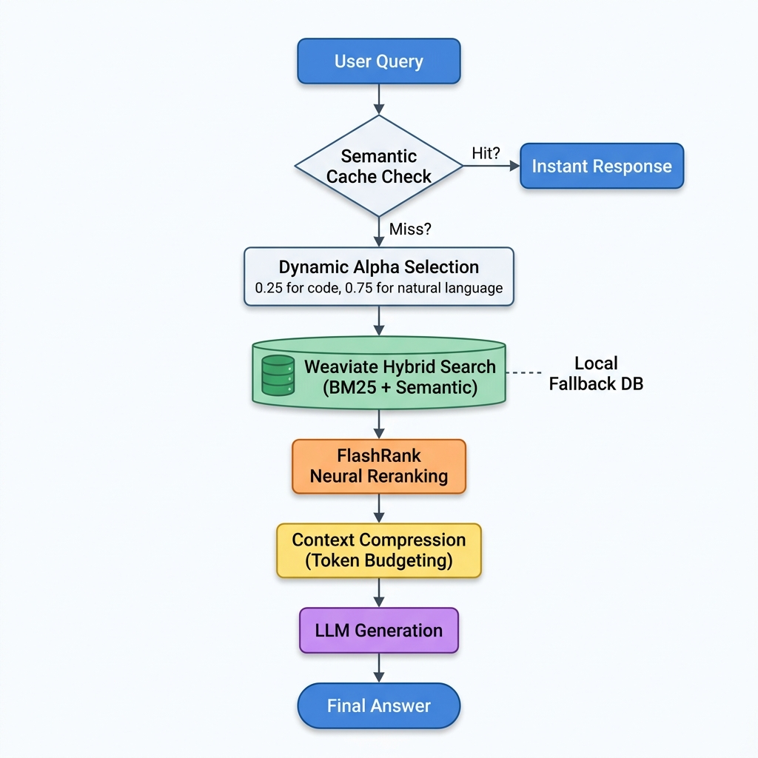
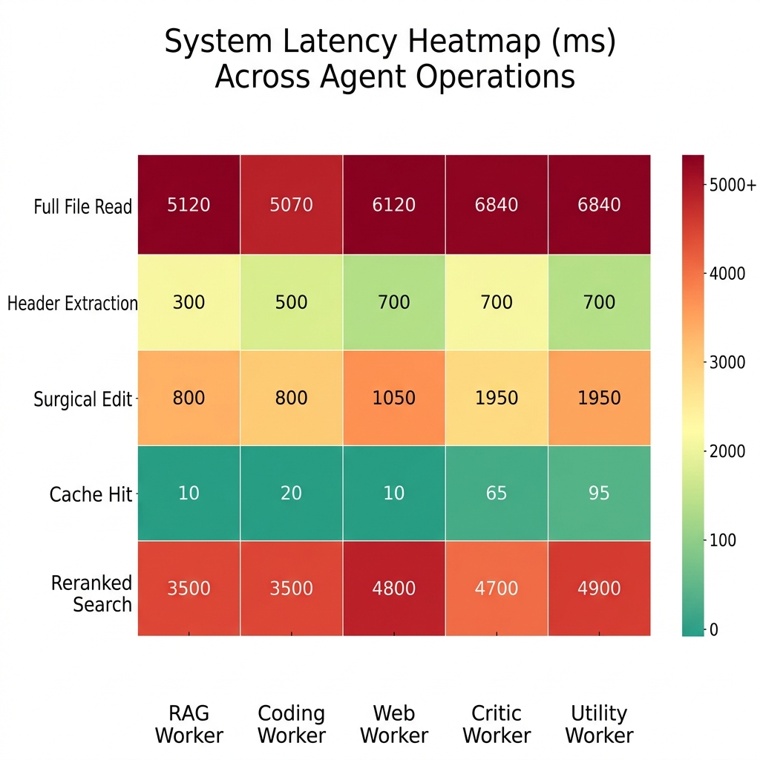
Visuals: RAG & Orchestration Engine Flow
Figure 3. System Latency Heatmap (ms)
Figure 2. Retrieval & Generation Pipeline Flow

Slide 8
Performance Savings: Surgical Code Edits
• The Problem: Conventional coding agents rewrite entire code files (7,000+ tokens) to change a few lines of code, consuming high generation tokens and increasing timeout rates.
• Surgical Approach: Implemented apply_surgical_edit which requires the agent to output only search-and-replace target blocks.
• AST-Based Header Fetching: Uses a parser (fetch_file_headers) to extract classes, functions, and import structures without loading the full implementation.
• Token Truncation: Truncates verbose command line outputs and logs to fit strict context parameters (achieving up to 88.3% token savings).

Slide 9
Performance Benchmarks & Metrics
• Structural Header Scan: Reduced context overhead by 99.79% (a 7,138-token file reduced to a
15-token header outline).
• Surgical Generation: Reduced output token volume by 99.55% during codebase editing.
• Semantic Context Compression: Compressed raw retrieval contexts by 20% to 58.3% while
dynamically retaining critical query terms.
• Log Output Summarization: Truncated long grep logs and compile outputs, achieving 88.3% token
savings and preventing context bloating.

Slide 10
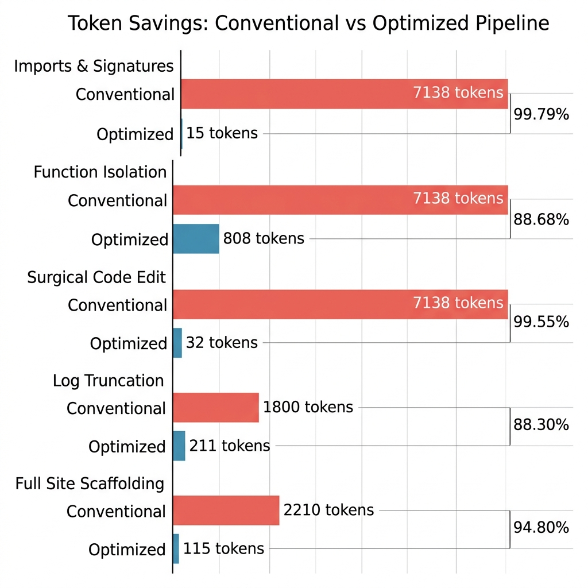
Visuals: Performance Tables
Optimization Scenario | Conventional Method | Optimized Method | Token Savings (%) | Key Advantage
Imports & Signatures Scan | Read full file (7,138 tokens) | fetch_file_headers (15 tokens) | 99.79% | Excludes implementation noise
Viewing Specific Function | Read full file (7,138 tokens) | get_pruned_context (808 tokens) | 88.68% | Isolates target code blocks
Applying Code Edits | Rewrite full file (7,138 tokens) | apply_surgical_edit (32 tokens) | 99.55% | Avoids rewriting full files
Log Output Parsing | Raw console logs (1,800 tokens) | Line-level truncation (211 tokens) | 88.30% | Retains critical compile errors
Full Site Scaffolding | Traditional LLM flow (2,210 tokens) | Optimized agentic loop (115 tokens) | 94.80% | Orchestrator-driven scaffolding
Figure 4. Token load comparison between conventional read/write and optimized surgical coding pipelines.

Slide 11
Conclusion
• Combining LangGraph multi-agent coordination with surgical context compression makes agentic development pipelines highly viable, fast, and cost-effective.
• Architectural Insights: Semantic caches and AST-based signature lookups are essential to prevent context window bloating in production-grade software engineering agents.
• The hybrid Weaviate vector engine with local fallback ensures high retrieval accuracy and system availability, showing that token-optimized context engineering is critical for scaling autonomous agentic pipelines.

Slide 12
OUTCOME
• Design and orchestration of multi-agent state machines (LangGraph) with routing supervisor pattern.
• Core integration of vector database endpoints (Weaviate Cloud) and dynamic alpha shifting (0.25 / 0.75).
• Advanced context pruning, token metrics, caching, and safety guardrails.
• Developed professional academic-level benchmarking and verification procedures.

Slide 13
THANK YOU
Presented by: Vasanthavel K (Reg no: 24CS1021)
Department of Computer Science and Engineering
Chennai Institute of Technology

